Slide 1
RESEARCH REPORT ON SELLING AND MARKETING
Student’s Name
Student ID
Professor’s Name
Date of Submission

Slide 2


Objective
The goal of the research is determine the effectiveness of south Africa as a country to expand the Aloe Hair Care product in South Africa
The other objective is help improve the company’s global rankings
The expansion is likely to encourage growth of the company
Notes:
The purpose of the study was to assess how the product would perform when introduced in South Africa. The research was also designed to determine the strategic sales location for Aloe Hair Care product in South Africa. The research was also meant to determine how the demographics would respond following the introduction of the product in the area of residence.

Slide 3

Scope
The research centers on the introduction of a new product in a foreign market which is South Africa.
South Africa is suitable for the global expansion plan since its population has embraced change and therefore do not have issues using manufactured products
There is a high potential in South Africa especially in Pretoria due to its huge population
Notes:
The study aims to concentrate on the company’s desire to expand globally by introducing a new product in the South African market. South Africa is an attractive country that has embraced manufactured products. There is a huge potential for growth in this country due to the presence of massive population in the targeted area of Pretoria.

Slide 4


Introduction
Cyton Aloe Co. Ltd is a company that deals with the manufacture and selling of beauty products.
The company is looking for opportunities to expand into the global market
The company has two options: opening its own shop or finding a suitable business partner
The potential country to expand to is South Africa.
Notes:
Cyton Aloe Co. Ltd is a company that specializes in the manufacture and sale of shampoos, hairsprays and anti-dandruff sprays. The products are important in ensuring that hair is moisturized, clean and having fresh scent. The company has found a suitable country to expand to which is South Africa. The decision is guided by positive attitude of the target audience towards the hair products, its willingness to purchase manufactured products and the attractiveness of the new product to the target audience

Slide 5

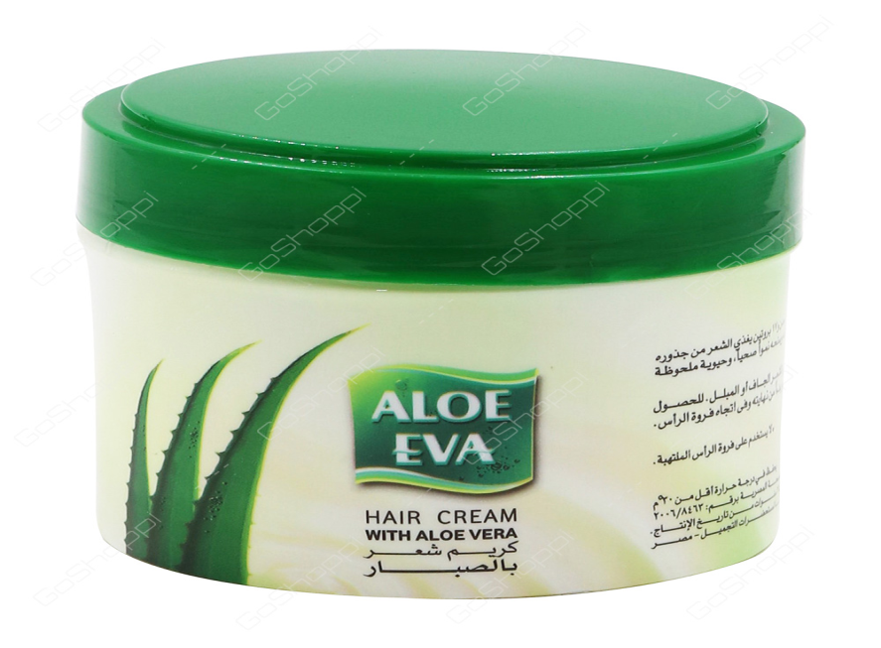
Discussion
The study discovered that many respondents liked to keep their hair clean, moisturized and clean.
Consumers find difficulty in getting a good product that suits their needs.
There were limited alternatives of hair products in the market.
Most consumers order alternative products through the internet from foreign countries.
The introduction of a new product that satisfied their need will help in addressing the problem.
Notes:
The company has decided to locate the business in Pretoria due to its huge population. The city’s most residents are youths and this is a positive indication of the product’s demand. The production process will take place in South Africa. The reason behind this is that the main ingredient of the product: Aloe Vera which is readily available in this country. The company will ensure that it advertises the product so that customers can know that it is responsibly sourced so that they can purchase it.

Slide 6


Conclusion
Aloe Hair Care is a product that is likely to do well in the South African market.
The consumers in this market show a great interest in hair products even though there are few alternatives in the market (“UNFPA South Africa”, 2018).
There a huge gap that needs to be filled.
Notes:
The south African market is attractive due to the huge number of consumers who demand hair products. The company is likely to benefit in this country since Aloe which is a key ingredient of Aloe Hair Care product is ready available. The company will be able to sell the product at an affordable price without compromising on the products quality (“UNFPA South Africa”, 2018).

Slide 7

Recommendation
Cyton Aloe Co. Ltd needs to ensure that it sells the product in thee south African market at a consumer-friendly price.
Constant inspection of the production site is critical to ensure that the high quality of the product is maintained.
Additionally, the company needs to invest more in internet and social media marketing to ensure that youths are targeted (Shapshak, 2017).
Notes:
The company needs to ensure that it offers the product to the South African market at a low price to attract customers. Further, the quality of the product need to be maintained. The company needs to invest in social media and internet marketing to reach the youths. It must also provide good customer service and ensure that the product is accessed easily so that the product sells as expected (Shapshak, 2017).

Slide 8
References
Shapshak, T. (2017). Forbes Welcome. Forbes.com. Retrieved 5 March 2018, from https://www.forbes.com/sites/tobyshapshak/2017/07/19/south-africa-has-21m-internet-users-mostly-on-mobile/#6917f03c1b2d
UNFPA South Africa | Young People. (2018). Southafrica.unfpa.org. Retrieved 5 March 2018, from http://southafrica.unfpa.org/en/topics/young-people-1

